Slide 1
Design Patterns
Structural Design Patterns

Slide 2
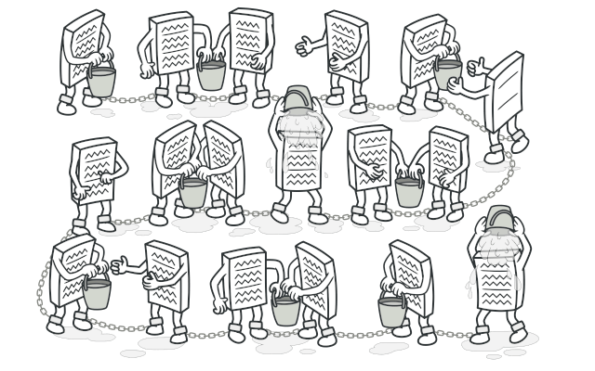
Chain of Responsibility
Transforming particular behaviors into stand-alone objects called handlers.
Each handler performs a function, has a link to the next function in the list and can decide to pass the request on

Slide 3
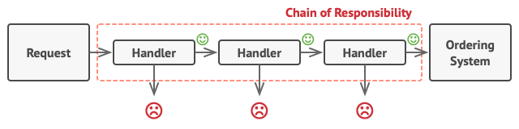
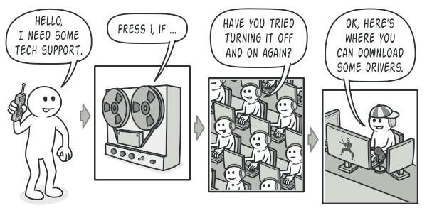
https://www.youtube.com/watch?v=i_dEHmWsZdA
Notes:
Transforming particular behaviors into stand-alone objects called handlers.

Slide 4
Command
Turns a request into a stand alone object that contains all the information about that request
Allows you to pass it as an argument, queue it and create undo operations

Slide 5
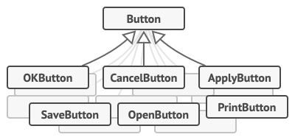
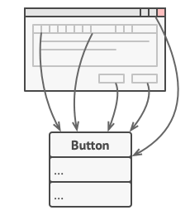
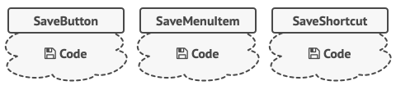
Your App has Many Buttons
Button
Each Button has its own Code
https://www.youtube.com/watch?v=XW-gKMFbOyc
Notes:
Start with a button > Many buttons in an app > Each button has its own code

Slide 6
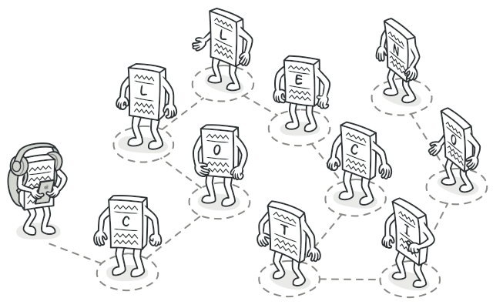
Intent
lets you traverse elements of a collection without exposing its underlying representation (list, stack, tree, etc.).

Slide 7

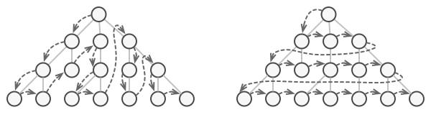
How do you iterate a tree?
https://www.youtube.com/watch?v=Gco6zF_ygSc

Slide 8
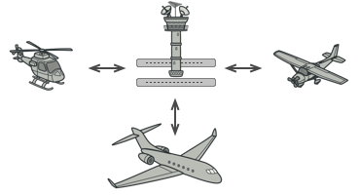
Mediator
Reduces chaotic dependencies between objects by having them communicate through a mediator object
https://www.youtube.com/watch?v=FDtPLhOpdQ8

